Slide 1
2022 Mapping Tool Advisory Committee (MTAC) Program
CIRCA OVERVIEW
Mary Buchanan, Ph.D., Community Resilience Planner
Yaprak Onat, Ph.D., P.E., Assistant Director of Research

Slide 2
Overview
Welcome
EJ Mapping Tool Project Background
Role of the Mapping Tool Advisory Committee (MTAC)
Applying for the MTAC Grant
Application Evaluation
Logistics and Timeline
Questions

Slide 3
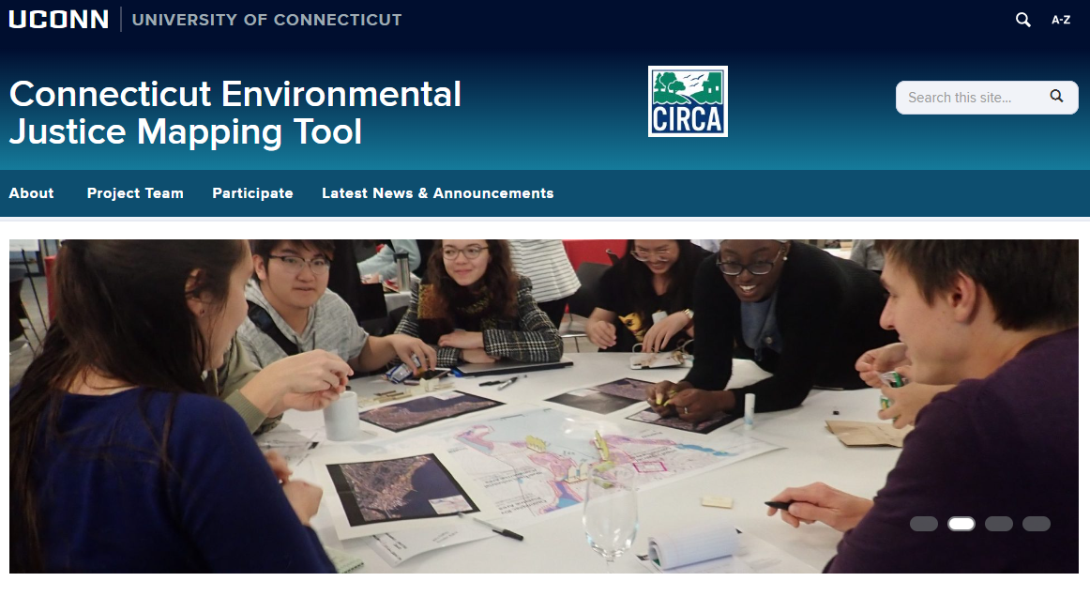
EJ Mapping Tool Project Background
In 2021, the Governor’s Council on Climate Change (GC3) Equity and Environmental Justice Working Group identified priority actions for near-term implementation, among them the development of a statewide environmental justice mapping tool.
(https://connecticut-environmental-justice.circa.uconn.edu/about/)
Notes:
“The purpose of this map is to identify vulnerable populations that may be disproportionately impacted by programs, policies, or projects and to inform initiatives for creating healthy communities. This project aims to build a community-state partnership to represent environmental and demographic indicators spatially, using deep community engagement and existing data efforts underway across the state. Once completed, this environmental justice screening tool can inform decision-making across state and local programs.”

Slide 4
Environmental Justice Mapping Tool Overview
Supplemented with local information and experience
Web-based GIS tool for statewide consistent EJ screening and mapping
Tool that is useful for State, County and Municipal policymaking
Notes:
The Connecticut Department of Energy and Environmental Protection (DEEP) and the University of Connecticut’s Connecticut Institute for Resilience and Climate Adaptation (CIRCA) are partnering on the development of an “Environmental Justice Map” (CT EJ Map) to identify vulnerable populations that may be disproportionately impacted by programs, policies, or projects and to inform initiatives for creating healthy communities.
The purpose of this map is to identify vulnerable populations that may be disproportionately impacted by programs, policies, or projects and to inform initiatives for creating healthy communities.
State mapping tools allow users to:
• Explore factors of environmental justice concern and community relevant scales,
•Determine/Compare ‘Score’ of different census tracts in the state, and
•View additional context layers relevant to their area of concern or the story they would like to tell
Starting point for further review for the potential for EJ concerns

Slide 5
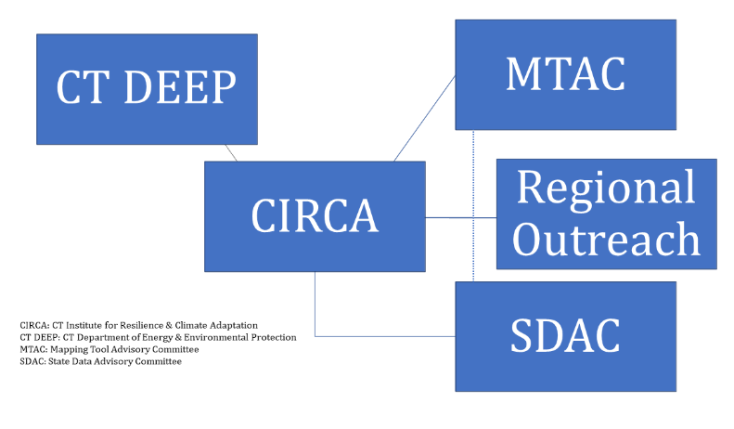
Project Partnerships

Slide 6
Data Categorization
Environmental Exposure
Environmental Effect
Pollution Burden
Environmental exposures: data from measured environmental concentrations and releases of contaminants from pollution sources.
Environmental effects: illustrate the potential risk of the environmental hazard on communities nearby.
Environmental Exposure
Environmental Effect
Notes:
Pollution burden: includes indicators related to the environmental health risk factors in communities:
The average percentile for each indicator is weighted equally within this theme.
as proximity to a potential exposure does not necessarily reflect actual exposure, this theme is down-weighted by one-half when averaged with environmental exposures in the pollution burden category.
(Brender, Maantay & Chakraborty, 2011).
as a way to quantify pollution burden from exposure to pollutants.

Slide 7
Data Categorization
Environmental Exposure
Population Characteristics
Environmental Effect
Sensitive populations: relate to biological susceptibility.
Socioeconomic factors: associated with environmental justice conditions.
Sensitive Populations
Socioeconomic Factors
Notes:
Population chatacteristics: intrinsic and extrinsic vulnerabilities in communities that can modify the environmental risk factors.

Slide 8
How can you use the tool?
Audience: public, agencies, stakeholders
Community outreach
Prioritization
Evaluating areas for place-based work
Education and research
Retrospective reporting

Slide 9
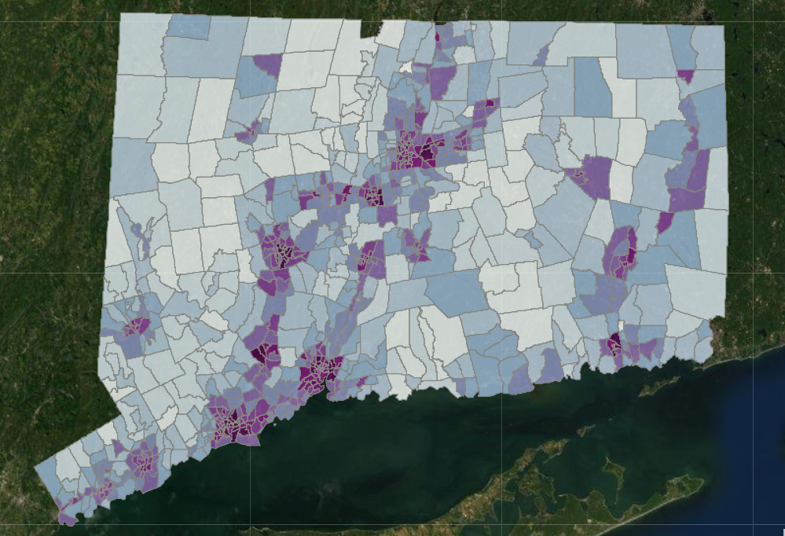
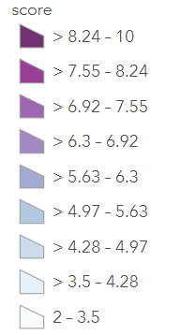
Environmental Justice Mapping Tool Overview

Slide 10
MTAC 2022 Overview
Goal: Fund organizations and individuals to advise on environmental justice mapping efforts for Connecticut
Amount: $5,000 each for 7 participants
Timeline: January 2023 – August 2023
Eligibility: Individuals with lived experience or representatives from community-based organizations (CBOs)
Deadline: October 12th 2022 at 5 pm

Slide 11
EJ Mapping Tool Project Background
Who is leading this project?
The Environmental Justice Mapping Tool is a partner project of CIRCA and DEEP.
How is community input being gathered?
Mapping Tool Advisory Committee (MTAC)
Public forums across the state in early 2023

Slide 12
EJ Mapping Tool Project Background
The primary role of the MTAC is to represent different interests that contribute to environmental justice including health, transportation, racial justice, education, and more, and to be partners in the refinement of the tool and its contents.
This grant program will fund participation in the MTAC to increase access to this input process.

Slide 13
What Will MTAC Members Do?
Each MTAC member will…
Watch introductory webinar on EJ mapping tool project.
Attend five virtual meetings (about 2 hours each) between January – June 2023.
Review meeting materials (draft forum agendas, latest EJ Map Viewer version), to be distributed in advance of meetings).
Attend a regional forum in early 2023 (choose from multiple dates/locations; mileage reimbursed).
Attend public meeting/launch and offer comments in August 2023.
Short project/participation evaluation mid-way through (April 2023) and at the end of the project (August 2023).

Slide 14
Option 1: Applying as an Individual
Who should apply?
Individuals with lived experience — in other words, individuals who have lived / are living with the issues the community is focusing on and who may have insight to offer about the system as it is experienced by consumers. These individuals will have:
Expertise that doesn’t come from training or formal education.
Knowledge from an experience with an issue or challenge.
Direct experience with a system, process, or issue, or trying to engage with a resource; and awareness of what works, what doesn’t work, and what resources (formal or informal) are available in the community.

Slide 15
Option 2: Applying as an Organization
Who should apply?
Community-Based Organization (CBO) – For purposes of this solicitation, a community-based organization refers to a private, non-profit (incorporated or unincorporated) or for-profit organization that is aimed at making desired improvements to a community's social health, well-being, and overall functioning, that is is representative of a community or significant segments of a community; and that provides services to individuals in the community based on input from community members.
CBOs could be 501(c)3 organizations, religious organizations, neighborhood groups, and other non-governmental organizations.
CBOs will need to nominate a representative to participate. The same representative should attend all MTAC meetings.
Sustained Engagement

Slide 16
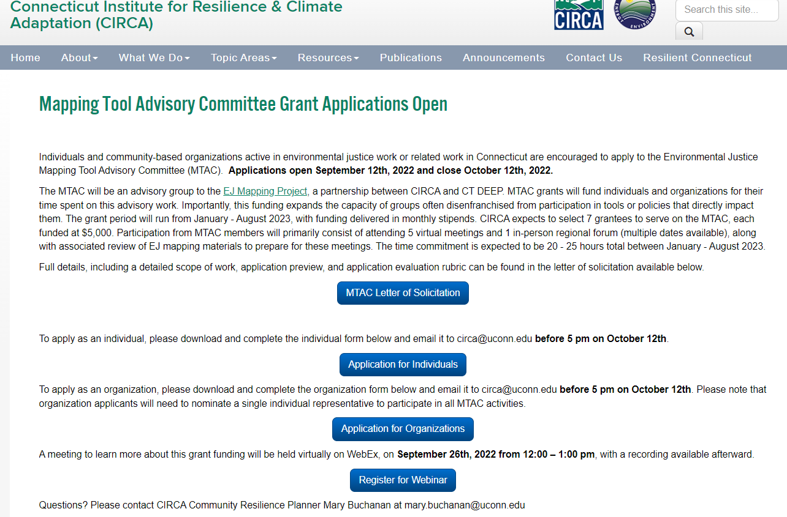
How to Apply
Deadline: October 12 at 5pm
Download and fill in the application form (including contact information as well as brief answers about relevant experience for this project) and email as a PDF to circa@uconn.edu
Organizations will also need to attach a brief letter of support from the organization’s leadership.
https://circa.uconn.edu/mapping-tool-advisory-committee-applications-open/
Notes:
Municipal letters of support

Slide 17
Required Information
For organizations:
Short letter of support from your organization’s leadership that clearly states who would represent the organization and that they would be available for the scope of work.
Description or screenshot of your organization’s mission or activities that demonstrate your commitment to environmental justice (1 paragraph)
Description of why the proposed person is the best representative for your organization (1 paragraph)
Description of how your organization can inform the EJ Map (1-3 paragraphs)
Description of how your organization’s participation could benefit your organization, either during or after the project period (1-3 paragraphs)
For individuals:
Short statement of commitment that you would be available for the scope of work
Description of your lived experience and/or expertise in environmental justice or related advocacy efforts (housing, transportation, health) (1-2 paragraph)
Description of how your experience and/or expertise can inform the EJ Map (1-3 paragraphs)
Description of how your participation could benefit your efforts towards environmental justice, either during or after the project period (1-3 paragraphs)
Notes:
Circa collaboration = including technical analysis, mapping, or legal/policy guidance;

Slide 18
Proposal Evaluation Criteria | Points
Eligibility Applicant has a commitment to environmental justice in their mission and/or activities Applicant organization (if applicable) has uploaded a letter demonstrating support from the organization’s leadership Individual applicant (if applicable) has demonstrated lived experience | Pass/Fail
Demonstrated Potential for Success Application includes a clear explanation of how the applicant’s expertise and/or experience will effectively inform the creation/use of an EJ map for CT (20 points) Applicant has a proven record of projects related to EJ planning or action (10 points) Applicant demonstrates readiness and capacity to participate in the project (10 points) | 40 points
Qualifications of Applicant Applicant can commit to the project (20 points) Applicant has a demonstrated commitment to environmental justice work (10 points) Applicant has a record of involvement in environmental justice or related advocacy of at least 6 months (10 points) | 40 points
Benefit to Applicant Application includes a clear explanation of how the applicant might benefit from participation in this project, either during or after the project period (20 points) | 20 points
Total Points | 100 points

Slide 19
Required Contracting Procedures
University of Connecticut award procedures must be followed by all entities selected to receive funds. A W-9 form will be needed to receive payment.
Funds will be dispersed as a monthly stipend.
If for some reason the individual or organization can no longer participate, payments will end at the start of the next month.
Mileage for travel to one of the regional forums will also be reimbursed.

Slide 20
Reporting
MTAC participants will be asked to complete a short evaluation of the project and their participation mid-way of the project (April 2023) and at the end of the project (August 2023), not to last more than 15 minutes each.
Attendance will be taken at each MTAC meeting.
No other reporting is required.

Slide 21
Timeline
Applications due: October 12th, 2022
Grantees notified: Early November 2022
MTAC Meetings: January – June 2023 (5, virtual)
Regional Forum: Early 2023
Evaluations: April and August 2023
Public Launch of EJ Map: August 2023

Slide 22
Helpful Links
MTAC Grant Announcement, with full Letter of Solicitation and application links: https://circa.uconn.edu/mapping-tool-advisory-committee-applications-open/
EJ Map Project Website: https://connecticut-environmental-justice.circa.uconn.edu/

Slide 23
QUESTIONS?
mary.buchanan@uconn.edu

